Slide 1
Readmission Prediction
王镇宇 葛林成

Slide 2
Multi-class classification task
What?
How?
Process data
Choose models
Apply methods

Slide 3
Process data
Drop
Features
Simplify
> 40% missing value | weight, payer_code, medical_specialty
Single value | examide, citoglipton
Gender unknow | Gender is Unknown/Invalid
No diagnoses | 3 diagnose value all missing
Died patients | ‘Expired’ patients never readmit
admission_type_id | [2, 7] → 1 |  | [6, 8] → 5
discharge_disposition_id | [6, 8, 9, 13] → 1 |  | [3, 4, 5, 14, 22, 23, 24] → 2
 | [19, 20, 21] → 11 |  | [12, 15, 16, 17] → 10
 | [25, 26] → 18
admission_source_id | [3, 2] → 1 | [13, 14] → 11 | [15, 17, 20, 21] → 9 | [5, 6, 10, 22, 25] → 4

Slide 4
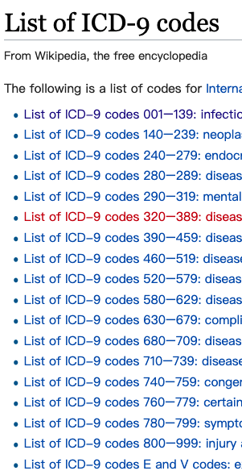
Process data
Create
num_med_changed: refers total prescription changes in 23 medicines
num_med_taken: refers total kinds of medicine taken in 23 medicines
Merge
num_treatment: refers total visit number of a patient which is the sum of
number_outpatient, number_emergency and number_inpatient
Abandoned
Encode
race, gender, AlCresults, max_glu_serum, diabetesMed…
Classify diagnose by IDC-9
19 kinds
Standardize

Slide 5
Dataset
Drop encounter_id, patient_nbr, diag_2, diag_3 while training
Readmission sample(total 86556):
Divide dataset with 39347 samples according to the ratio of 4:1
Sampling (SMOTE)
>30 readmmission | 30708
<30 readmmission | 9399
Never readmmission | 46449
train_set | 11477
test_set | 27870

Slide 6
Models
XGBoost
A scalable end-to-end tree boosting system
With accuracy of 57.09% and MACRO-F1 of 0.43
Cross Validation score: | 0.59832
Accuracy: | 0.57093
Confusion matrix: | [[7624 106 1526] [1186 58 670] [3806 134 2202]]
Overall report： |  | precision | recall | f1-score | support
 | 0 | 0.60 | 0.82 | 0.70 | 9256
 | 1 | 0.19 | 0.03 | 0.05 | 1914
 | 2 | 0.50 | 0.36 | 0.42 | 6142
macro avg |  | 0.43 | 0.40 | 0.39 | 17312

Slide 7
Models
Random Forest
Correct for decision trees' habit of overfitting to their training set
With accuracy of 56.20% and MACRO-F1 of 0.45
Cross Validation score: | 0.67027
Accuracy: | 0.56203
Confusion matrix: | [[7347 76 1833] [1181 53 680] [3723 89 2330]]
Overall report： |  | precision | recall | f1-score | support
 | 0 | 0.60 | 0.79 | 0.68 | 9256
 | 1 | 0.24 | 0.03 | 0.05 | 1914
 | 2 | 0.48 | 0.38 | 0.42 | 6142
macro avg |  | 0.44 | 0.40 | 0.39 | 17312

Slide 8
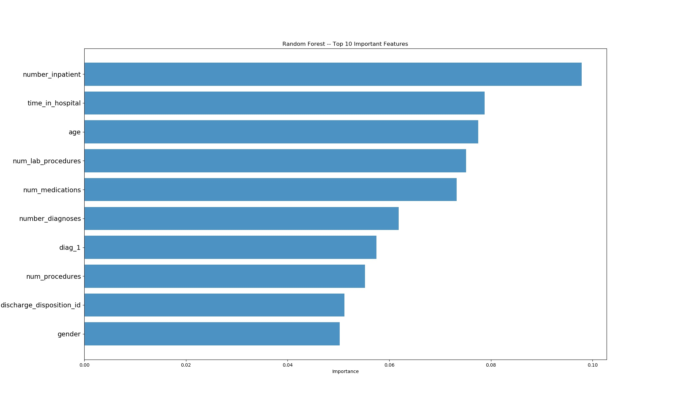
Feature Importance

Slide 9
Q&A

